Slide 1

Data Communication CSE 315
Dr. A.K.M. Muzahidul Islam
Professor
Computer Science & Engineering (CSE)
United International University (UIU)
Fall 2018

Slide 2
Schedule
Section ‘B’
Sat/Tuesday
11:40 a.m.~ 1:10 p.m.
Room No. 0332 (Level 3)
Counseling
14:00 p.m.~ 16:00 p.m.
Room No. 333/D (Level 3)
Section ‘C’
Sun/Wednesday
1:30 p.m.~ 3:00 p.m.
Room No. 0328 (Level 3)
Counseling
11:00 p.m.~ 13:00 p.m.
Room No. 333/D (Level 3)

Slide 3
Assessment
Attendance : 5%
Assignments : 5%
Class Tests : 20%
Mid Term : 30%
Final : 40%
Grading Policy
A (Plain) : 90-100 C+ (Plus) : 70-73
A- (Minus) : 86-89 C (Plain) : 66-69
B+ (Plus) : 82-85 C- (Minus) : 62-65
B (Plain) : 78-81 D+ (Plus) : 58-61
B- (Minus) : 74-77 D (Plain) : 55-57

Slide 4
Resources
Data Communications and Networking. Behrouz A. Forouzan
Data and Computer Communications. William Stallings (TENTH EDITION)
Modern Digitial and Analog Communication Systems. BP-Lathi Zhi Ding (4th edition)
Computer Networks Andrew S. Tanenbaum

Slide 5
Outline
Introduction to IP Addressing
I Introduction to Wireshark
OSI and TCP/IP Layer

Slide 6
Layered Models
The Layered Approach
Early stage DECnet and IBM could not communicate with each other.
Thus in late 1970s the Open Systems Interconnection (OSI) reference model was created by the ISO to break the barrier.
A reference model is a conceptual blueprint of how communications should take place.
It addresses all the processes required for effective communication and divides these processes into logical groupings called layers.
When a communication system is designed in this manner, it’s known as layered architecture.
6

Slide 7
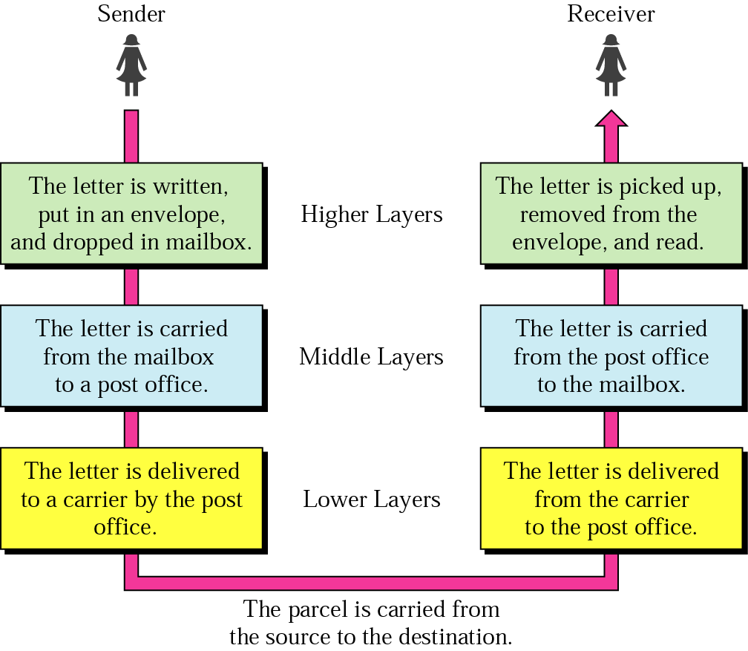
The OSI Model
The OSI isn’t a physical model. Rather, it’s a set of guidelines that application developers can use to create and implement applications that run on a network.
It also provides a framework for creating and implementing networking standards, devices, and internetworking schemes.
7

Slide 8
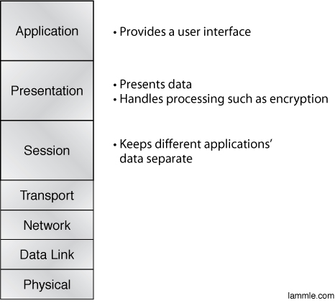
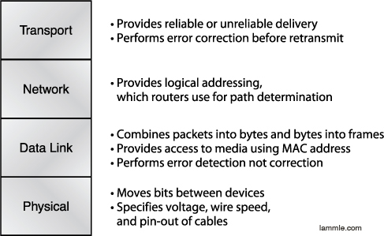
The OSI Model
The upper layers (i.e. TOP THREE Layers define how the applications within the End stations will communicate with each other and with users.
The bottom layers (i.e. FOUR Layers define how Data is transferred through a physical wire or Switches and Routers.
8

Slide 9
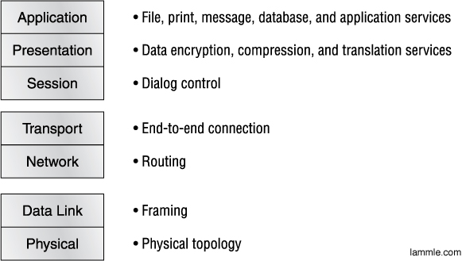
The OSI Model (Cont’d)
Summary of the Functions defined at each layer of the OSI Model
9

Slide 10
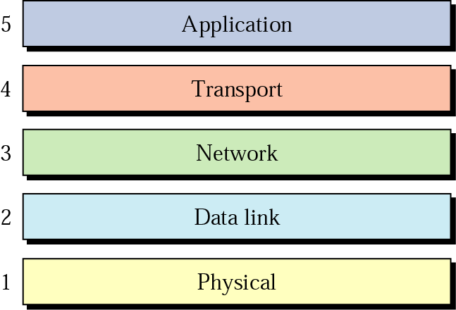
Internet Layers
The Five-layer Internet Model or TCP/IP Model dominates data communication and Networking Today, Layer 1 to 5

Slide 11
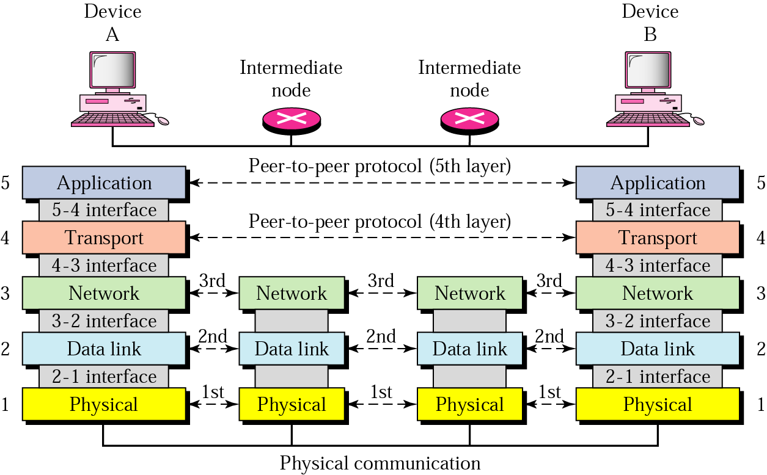
Peer-to-Peer Processes
When message is sent from Device A to B, the intermediate nodes are involved in Layer 1 to 3 only.
In a single machine, each layer calls upon the services of the layer just below it, whereas between machines the same layers are communicated.
Group 1: Layer 5
Application: Interoperability among unrelated software.
Group 2: Layer 4
Links the two subgroups to ensure that what the lower groups is delivering is readable
Group 3: Layer 1 to 3
Network support layer, that physically move data between devices.

Slide 12
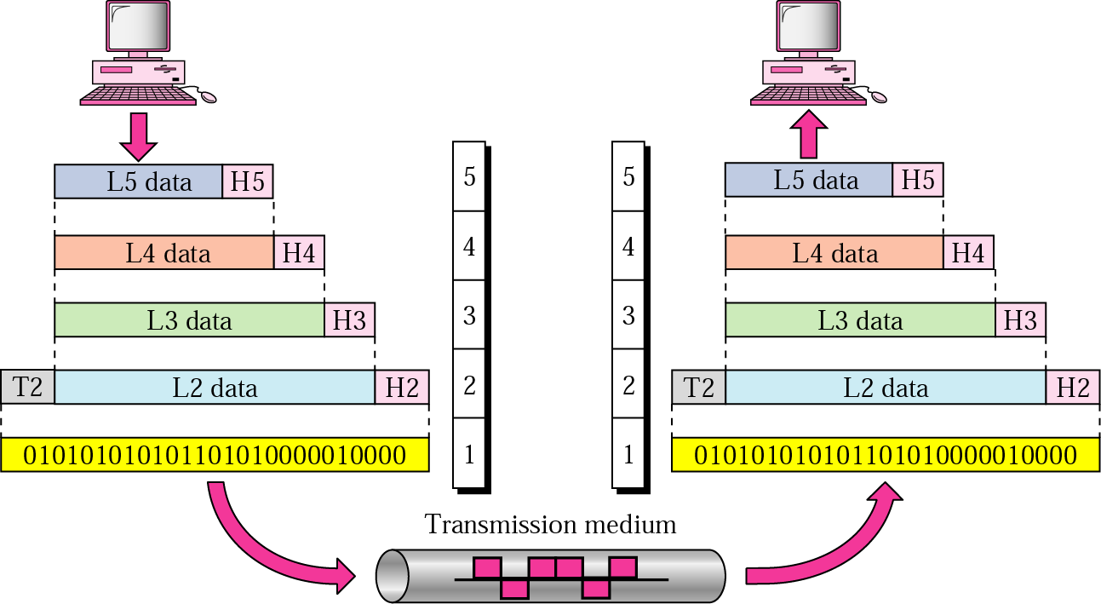
Exchange using the Internet Model
The process starts at Layer 5 then moves from layer to layer in descending, sequential order, where at each Layer a Header (Hx) is added to Data unit (Lx).
When the formatted data unit passes through Layer 1 it is changed into an Electromagnetic Signal and transported along a Physical Link.

Slide 13
Notes:
In general terms, computer communications can be said to involve three agents:
applications, computers, and networks. Examples of applications include file
transfer
and electronic mail. The applications that we are concerned with here are
distributed applications that involve the exchange of data between two computer
systems. These applications, and others, execute on computers that can often support
multiple simultaneous applications. Computers are connected to networks, and
the data to be exchanged are transferred by the network from one computer to
another. Thus, the transfer of data from one application to another involves first
getting the data to the computer in which the application resides and then getting
the data to the intended application within the computer. With these concepts in
mind, we can organize the communication task into five relatively independent
layers
(Figure 2.3):
• Physical layer
• Network access/data link layer
• Internet layer
• Host-to-host, or transport layer
• Application layer

Slide 14


Slide 15
Protocols
Protocol
A set of rules that govern data communication
For communication to occur, entities must agree upon a protocol
Ex. TCP/IP (de facto) and
IPX/SPX (Novell NetWare operating systems)
Key elements of a protocol
Syntax: structure or format of data
Semantics: meaning of each section in the structure
Timing: when and how fast data should be sent

Slide 16
Standards
Standards is essential in
Creating/maintaining open and competitive markets
Guaranteeing national/international interoperability
Ex. IEEE 802.3 (Ethernet) 802.11 (Wi-Fi)
Two categories
De jure (“by law”) standards
De facto (“by fact”) standards
Proprietary standards: closed standards
Nonproprietary standards: open standards

Slide 17
Standards Committees
ISO - Voluntary international organization
ITU-T - Formerly, CCITT formed by UN
ANSI - Private non-profit corporation in the US
IEEE - The largest engineering society in the world
EIA - Non-profit organization in the US
Internet Standards
Draft
RFC (Request for Comment)

Slide 18
TCP/IP Address Requirements
Two levels of addressing are needed:
Each host on a subnetwork must have a unique global internet address
Each process with a host must have an address (known as a port) that is unique within the host
Notes:
As is mentioned in Section 2.2, every entity in the overall system must have
a unique address. Each host on a subnetwork must have a unique global internet
address; this allows the data to be delivered to the proper host. Each process with a
host must have an address that is unique within the host; this allows the host-to-host
protocol (TCP) to deliver data to the proper process. These latter addresses are
known as ports .

Slide 19

IP Addressing
An IP address is a numeric identifier assigned to each machine on an IP network.
It designates the specific location of a device on the network.
IP addressing was designed to allow hosts on one network to communicate with a host on a different network regardless of the type of LANs the hosts are participating in.
19

Slide 20
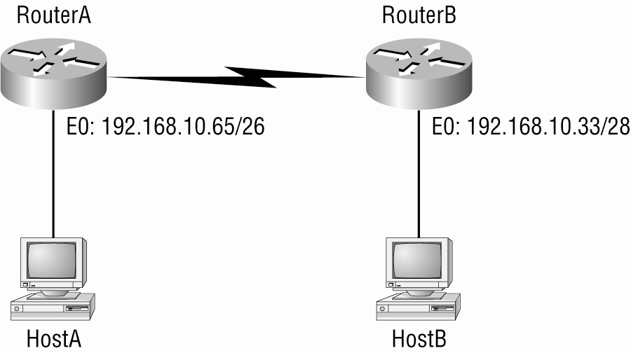
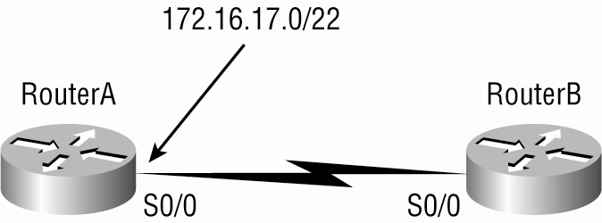
IP Addressing (Cont’d)

Slide 21
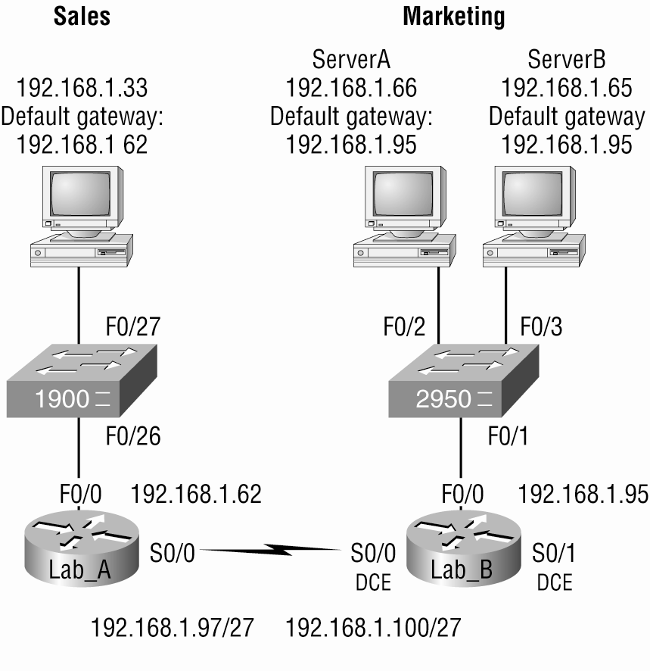
IP Addressing (Cont’d)

Slide 22
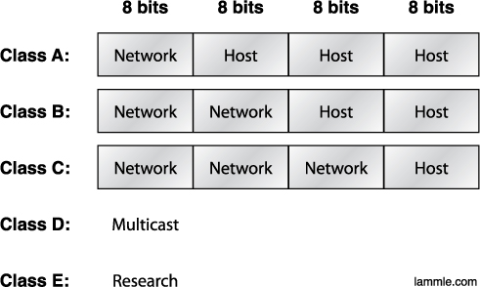
Network Addressing
Subdividing an IP address into a network and node address is determined by the class designation of one’s network. This figure summarizes the three classes of networks
IP Address:
192.168.100.70
192. 168. | 100.70
22

Slide 23
Network Addressing
Class A: 0xxx xxxx
0000 0000 = 0 - reserved for router
0111 1111 = 127 - reserved for diagnostics
Usable is from 1 until 126 ex. 49.22.102.70
Class B: 10xx xxxx
1000 0000 = 128
1011 1111 = 191
Class C: 110x xxxx
1100 0000 = 192
1101 1111 = 223
Class D: 224 – 239
Class E: 240 - 255
23

Slide 25
Private Addressing
Address Class Reserved Address Space
Class A 10.0.0.0 through 10.255.255.255
Class B 172.16.0.0 through 172.31.255.255
Class C 192.168.0.0 through 192.168.255.255
25

Slide 26
Reserved Addressing
Address Function
Network address of all 0s Interpreted to mean “this network or segment.”
Network address of all 1s Interpreted to mean “all networks.”
Network 127.0.0.1 Reserved for loopback tests.
Node address of all 0s Interpreted to mean “network address” or any host on specified network.
Node address of all 1s Interpreted to mean “all nodes” on the specified network
Entire IP address set to all 0s Used by Cisco routers to designate the default route. Could also mean “any network.”
Entire IP address set to all 1s (same as Broadcast to all nodes on the current network; 255.255.255.255) sometimescalled an “all 1s broadcast” or limited broadcast.
26

Slide 27
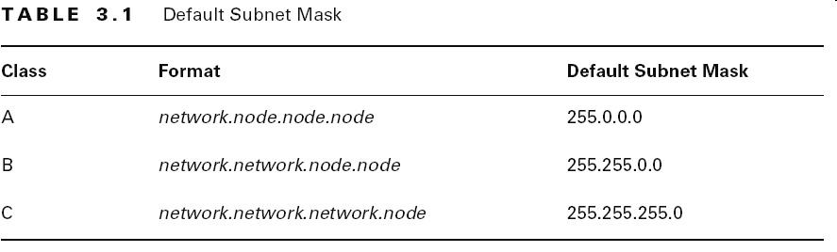
Subnet Masks

Slide 28
System Port (0 ~ 1023)
21: File Transfer Protocol (FTP)
22: Secure Shell (SSH)
23: Telnet remote login service
25: Simple Mail Transfer Protocol (SMTP)
53: Domain Name System (DNS) service
80: Hypertext Transfer Protocol (HTTP) used in the World Wide Web
110: Post Office Protocol (POP3)
119: Network News Transfer Protocol (NNTP)
123: Network Time Protocol (NTP)
143: Internet Message Access Protocol (IMAP)
161: Simple Network Management Protocol (SNMP)
194: Internet Relay Chat (IRC)
443: HTTP Secure (HTTPS)
http://www.ip-tracker.org/locator/ip-lookup.php
Notes:
http://www.ip-tracker.org/locator/ip-lookup.php?ip=91.198.22.70

Slide 30
IPv6
Larger Address Space
Aggregation-based address hierarchy
– Efficient backbone routing
Efficient and Extensible IP datagram
Stateless Address Autoconfiguration
Security (IPsec mandatory)
Mobility

Slide 31
128-bit IPv6 Address
3FFE:085B:1F1F:0000:0000:0000:00A9:1234
8 groups of 16-bit hexadecimal numbers separated by “:”
Leading zeros can be removed
3FFE:85B:1F1F::A9:1234
:: = all zeros in one or more group of 16-bit hexadecimal numbers

Slide 32
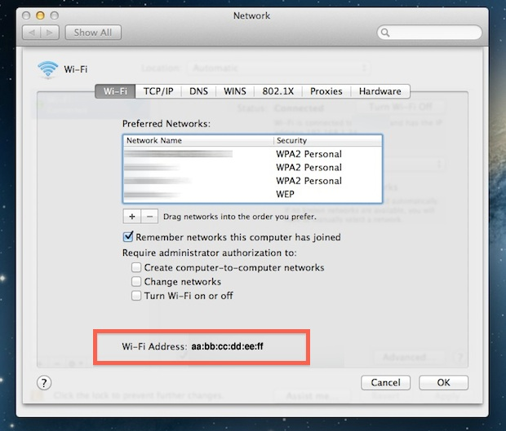
 -> System Preferences - > Network -> Interface
 : bash-3.2$ networksetup –listallhardwareports
Windows: IPCONFIG /ALL

Slide 34

WireShark?
Wireshark is a network packet/protocol analyzer.
A network packet analyzer will try to capture network packets and tries to display that packet data as detailed as possible.
Wireshark is perhaps ONE of THE BEST open source packet analyzers available today for UNIX and Windows.

Slide 35
Some intended purposes
Network administrators use it to troubleshoot network problems
Network security engineers use it to examine security problems
Developers use it to debug protocol implementations
People use it to learn network protocol internals
However,
Wireshark isn't an intrusion detection system.
Wireshark will not manipulate things on the network, it will only "measure" things from it.

Slide 36
Wireshark Interface

Slide 38
Thank You

